Slide 1
Heart Disease Prediction Using Logistic Regression
Project By - Asish Bose

Slide 2
Project Problem Statement
Heart disease is one of the leading causes of death globally. Early detection can significantly improve treatment outcomes.
Objective of the Project :
To build a machine learning model that predicts whether a person has heart disease based on medical attributes such as:
  Age
  Gender
  Cholesterol level
  Blood pressure
  BMI
  Diabetes
  Smoking habits
  Heart rate
  Glucose
Why this problem is important :
Helps in early medical diagnosis
Supports doctors in decision-making
Improves patient monitoring & awareness

Slide 3
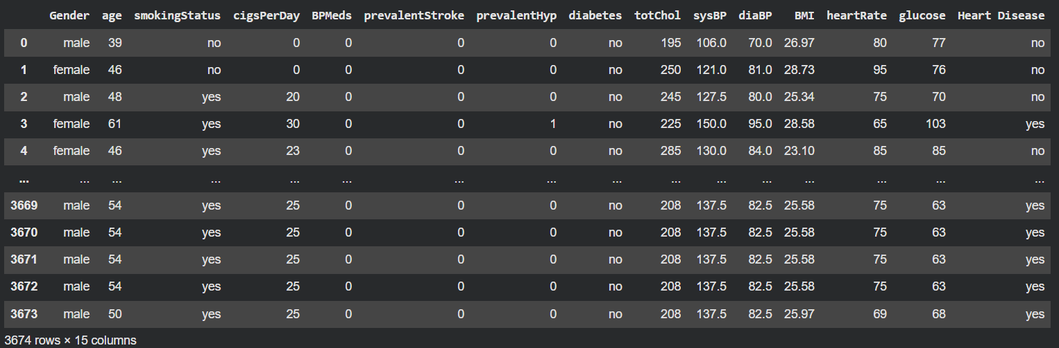
DATASET

Slide 4
Data Preprocessing
Steps Performed :
1. Loaded Dataset
2. Cleaned Data
Removed unnecessary column like education
Detected missing values in smokingStatus
Replaced invalid entries (-1) with NaN
Dropped remaining missing rows
Imported dataset using Pandas Checked shape, columns, missing values
3. Encoded Categorical Columns
Converted categories to numbers using .cat.codes:
Gender
Smoking Status
Diabetes
Heart Disease (Target)
4. Feature Scaling (Optional)
5. Train-Test Split
Not required for Logistic Regression, but can improve convergence.
80% training data
20% testing data

Slide 5
MODEL CREATION
Logistic Regression Model :
Why Logistic Regression?
Works well for classification (yes/no)
Simple, interpretable, fast
Best for medical prediction problems
Steps :
model = LogisticRegression()
model.fit(X_train, y_train)
Model Evaluation :
Predictions were made on test data
Calculated accuracy score
Final Accuracy
85.13%

Slide 6
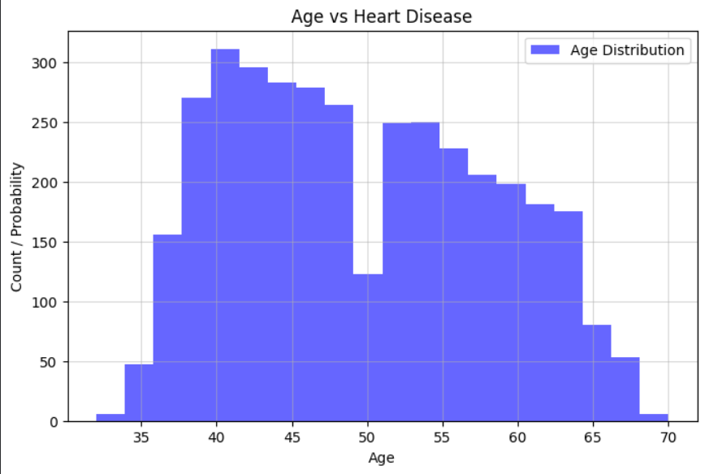
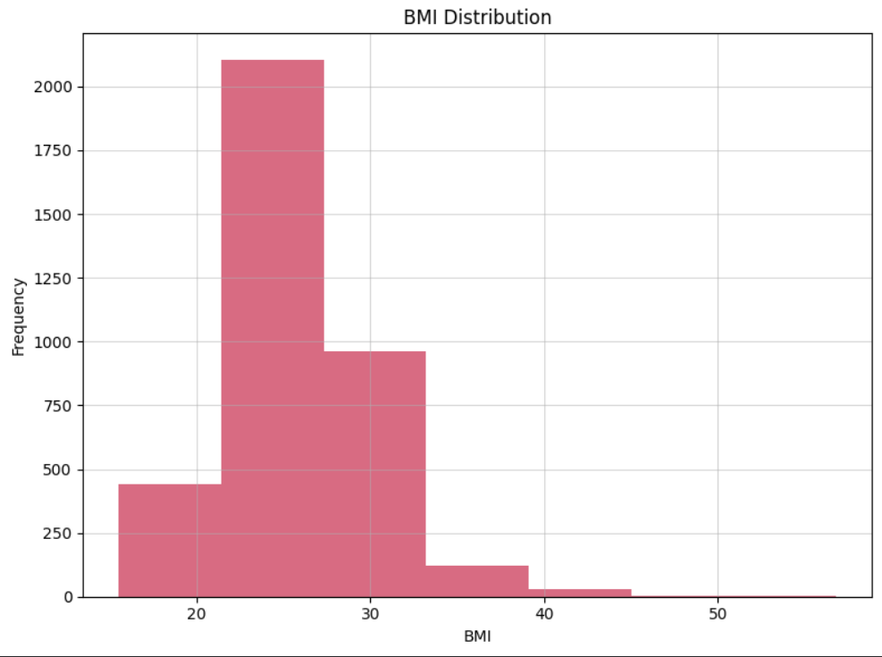
GRAPHICAL ANALYSIS
1. Age Vs Heart Disease
2. BMI Distribution Vs Heart Disease

Slide 7
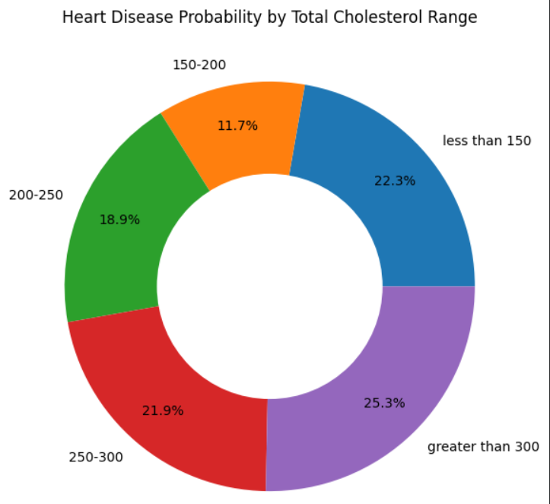
GRAPHICAL ANALYSIS
3.Heart Disease Probability by Total Cholesterol Range

Slide 8
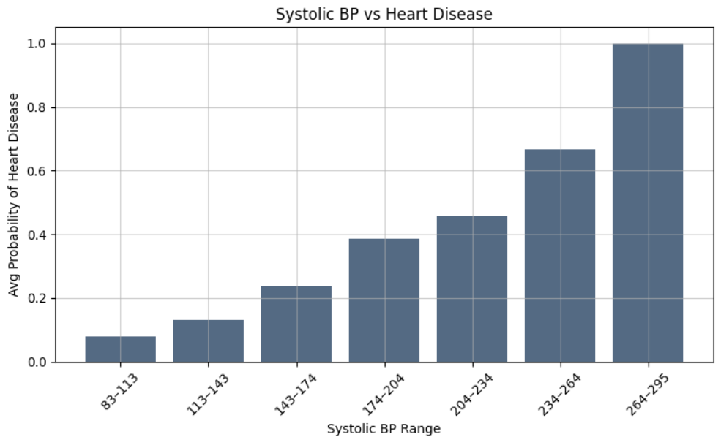
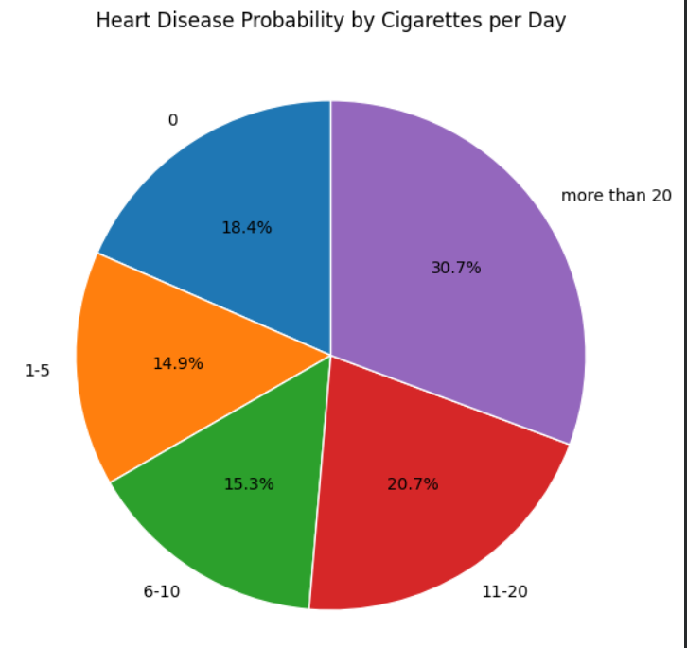
GRAPHICAL ANALYSIS
4.Systolic BP vs Heart Disease
5. Heart Disease Probability by Cigarettes per Day

Slide 9
CONCLUSION
Logistic Regression performed well with an 85% accuracy, making it a reliable baseline model.
Important factors contributing to heart disease include:
  High systolic blood pressure
  High cholesterol levels
  Higher BMI
  Smoking habits
  Age
Data preprocessing had a major impact on improving model performance.
Visual analysis confirms the relationships between health parameters and heart disease.
This model can be further improved using:
  Feature scaling
  Hyperparameter tuning
  Other ML models like Random Forest
This project provides a strong foundation for medical diagnosis using machine learning and highlights the potential of data-driven healthcare.

Slide 10
THANK YOU…..

